Slide 1
DREAMPlace
group1
2024/10/30

Slide 2
Outline
Introduction
Installation Flow
Install Dependencies
Build DREAMPlace
Run DREAMPlace
ISPD2019 Benchmark
Issues
Demo

Slide 3
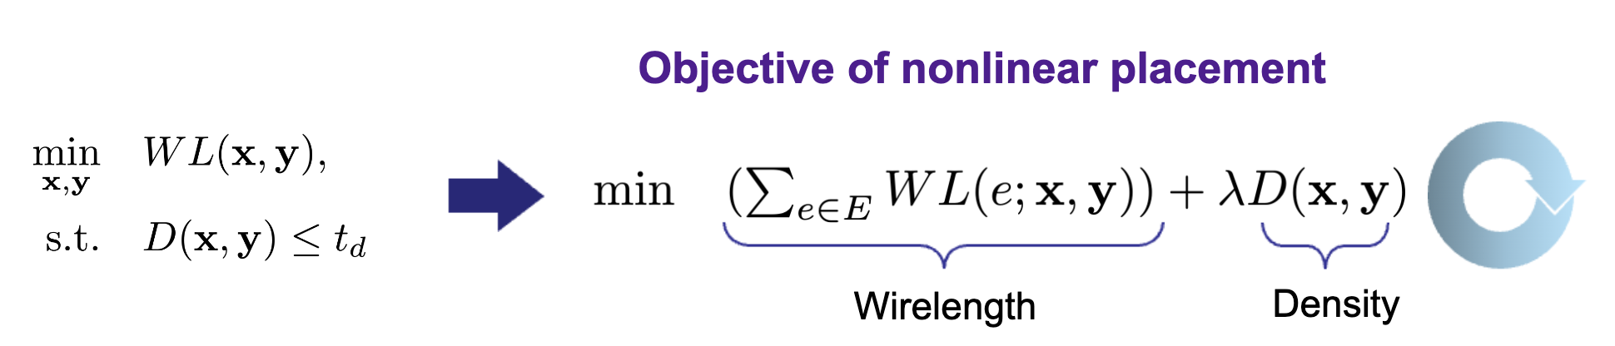
Introduction
electrostatics-based placement (ePlace)
Nesterov’s method nonlinear optimizer
Low efficiency and huge development effort
A novel analogy by casting the nonlinear placement optimization into a neural network training problem
source

Slide 4
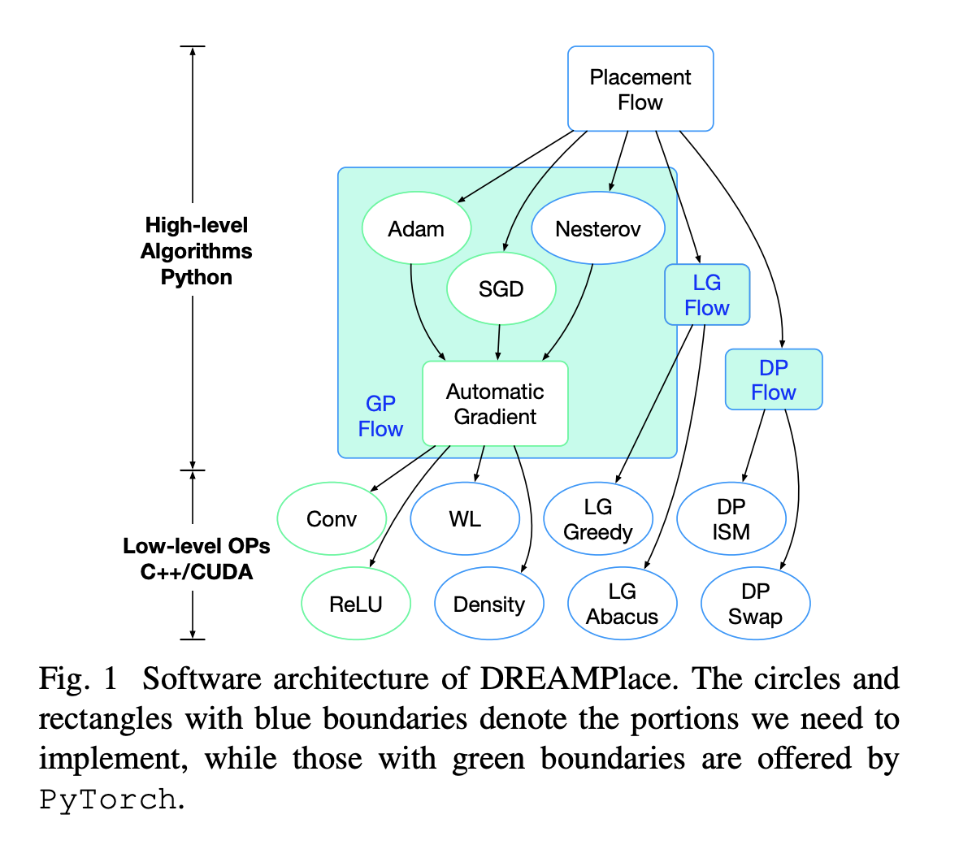
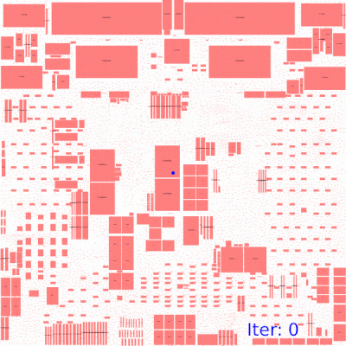
Introduction
Deep learning toolkit-enabled VLSI placement
Enable ultra-high parallelism and acceleration
Leverage highly optimized PyTorch
Customized CUDA kernel operator

Slide 5
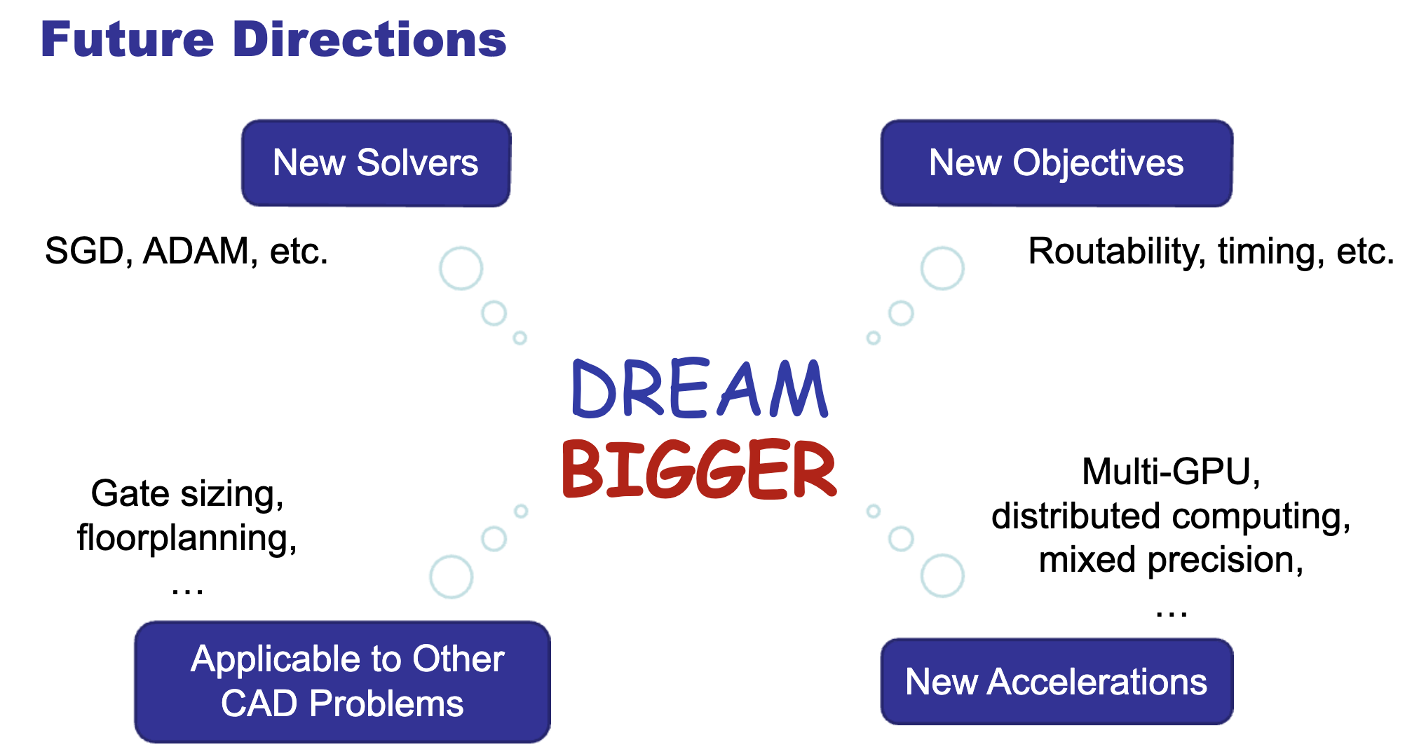
Introduction
ePlace/RePlace
DREAMPlace
ABCDPlace
DREAMPlace 2.0
DREAMPlace 3.0
DREAMPlace 4.0
DREAMPlace 4.1.0
source
source

Slide 6
Installation Flow

Slide 7
Install DREAMPlace dependency package
python = 3.9
pytorch = 1.8.0
gcc = 7.5
boost = 1.86.0
bison = 3.6

Slide 8
Build DREAMPlace
cd ~/DREAMPlace
mkdir build => the location for compile DreamPlace
cd build
mkdir ~/local/DREAMPlace => the location for install DreamPlace
cmake .. -DPython_EXECUTABLE=/home/user/group1/miniconda3/envs/Dreamplace_py3.9/bin/python -DCMAKE_INSTALL_PREFIX=/home/user/group1/local/DREAMPlace -DCMAKE_CUDA_FLAGS=-gencode=arch=compute_89,code=sm_89
make -j $(nproc)
make install
補充: CMAKE_CUDA_FLAGS is for GPU device compatibility

Slide 9
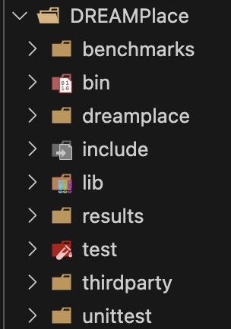
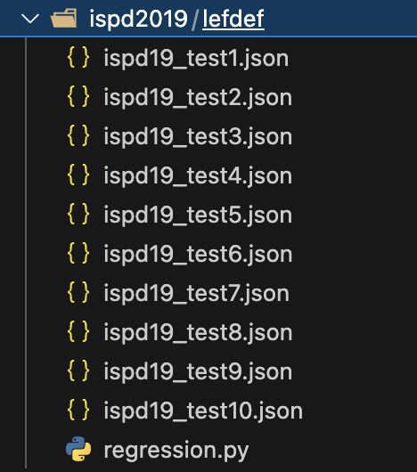
Run DREAMPlace
benchmarks (ISPD2005, ISPD2015, ISPD2019…)
dreamplace (source codes)
results
test (JSON file for DREAMPlace parameters)

Slide 10
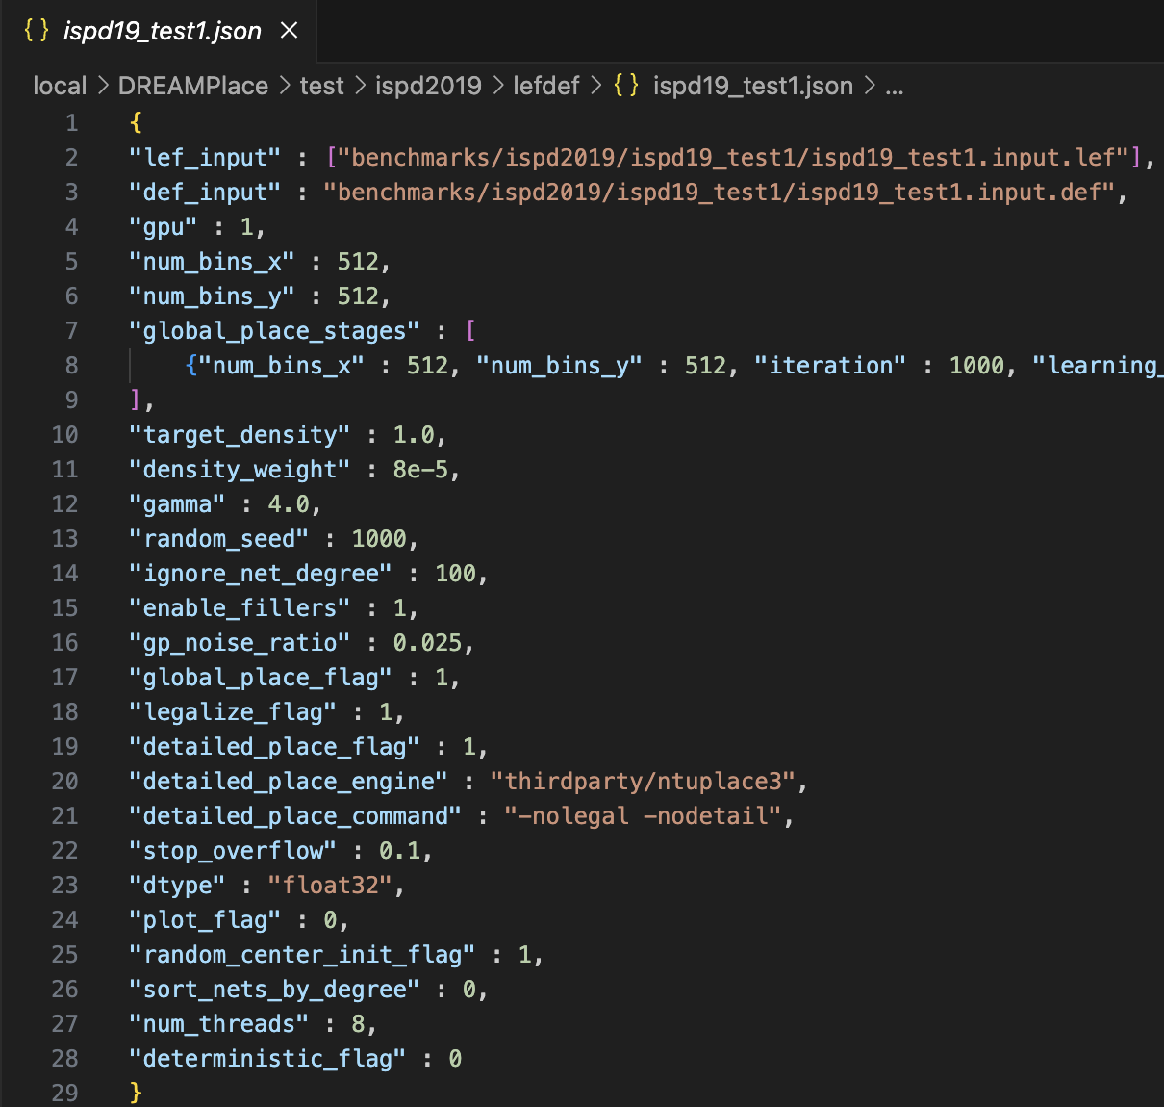
Run DREAMPlace
Activate the python env
cd ~/local/DREAMPlace
conda activate Dreamplace_py3.9
Get benchmarks
python benchmarks/ispd2019.py
Adjust the parameters of testcase
ispd19_testX.json
RUN !!!
python dreamplace/Placer.py /test/ispd2019/lefdef/ispd19_test1.json

Slide 11
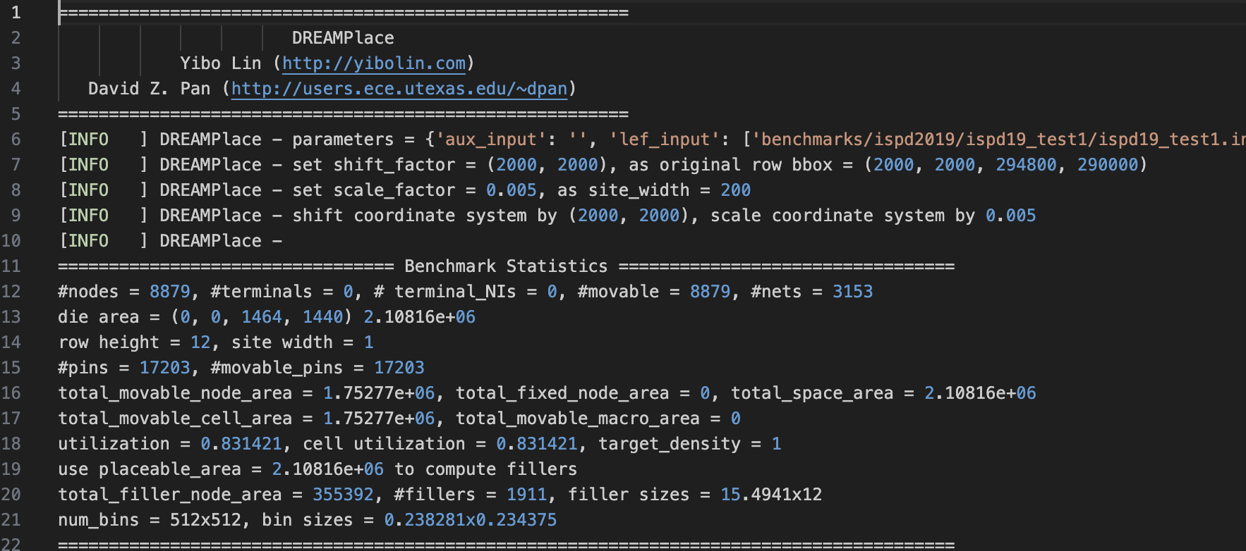
Run DREAMPlace

Slide 12
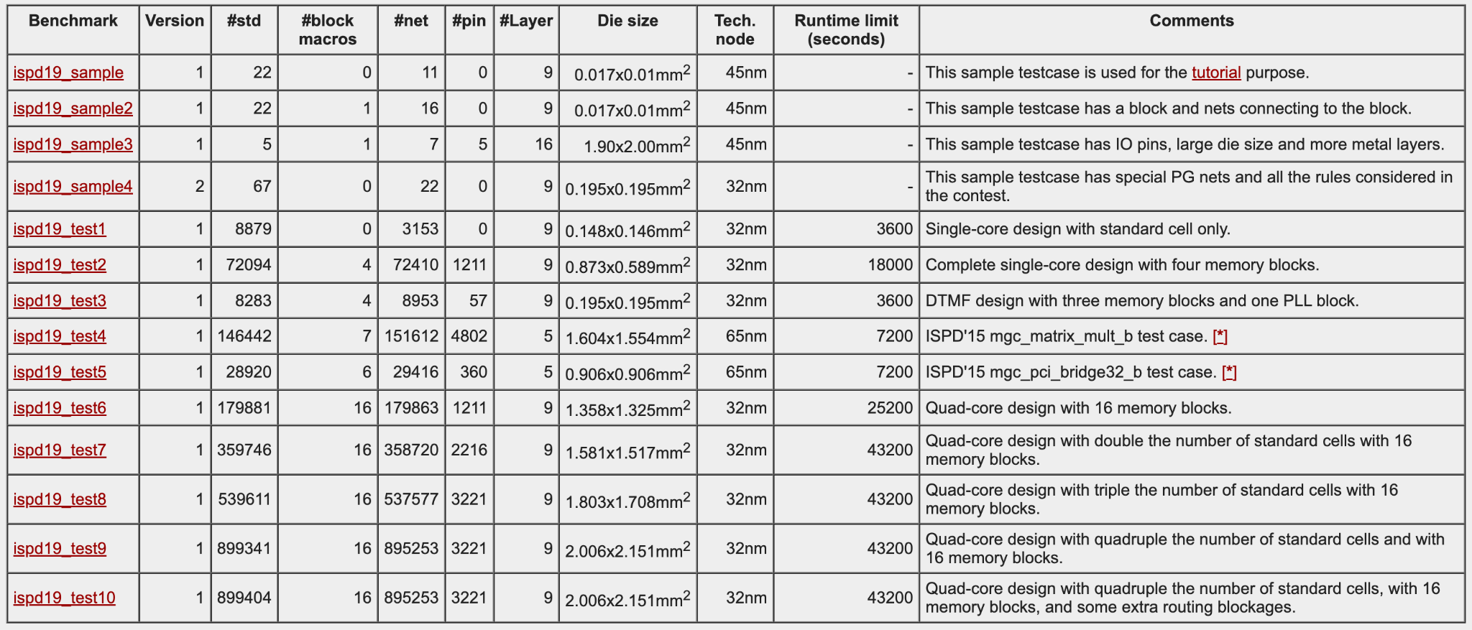
ISPD2019 Benchmarks
ISPD 2019 Contest on Initial Detailed Routing

Slide 13
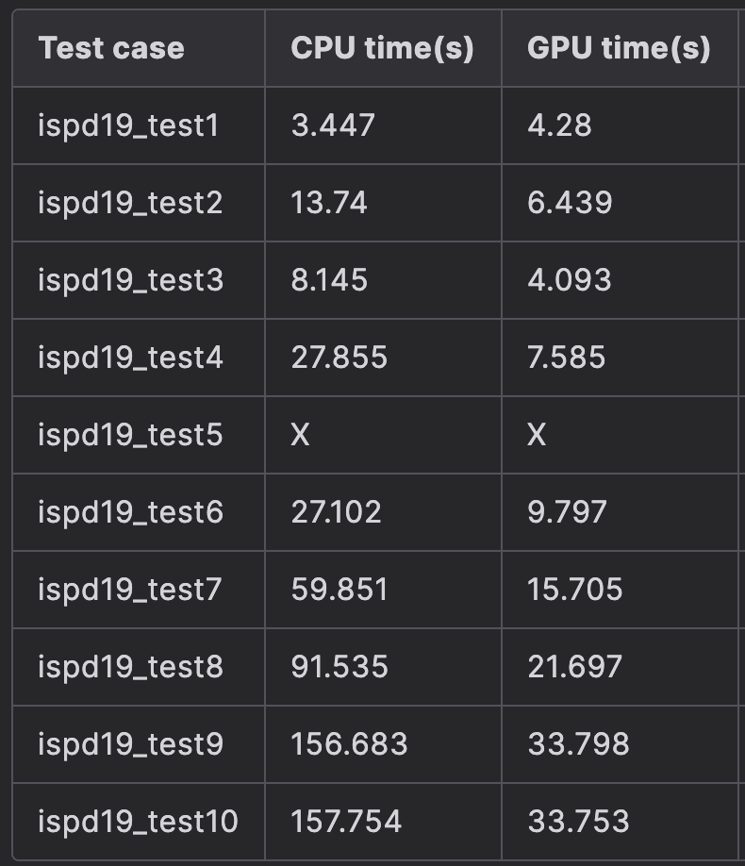
ISPD2019 Benchmarks
Run time of GP and LG
Parameters
iteration : 1000
learning_rate : 0.01
wirelength : "weighted_average"
optimizer : "nesterov"

Slide 14
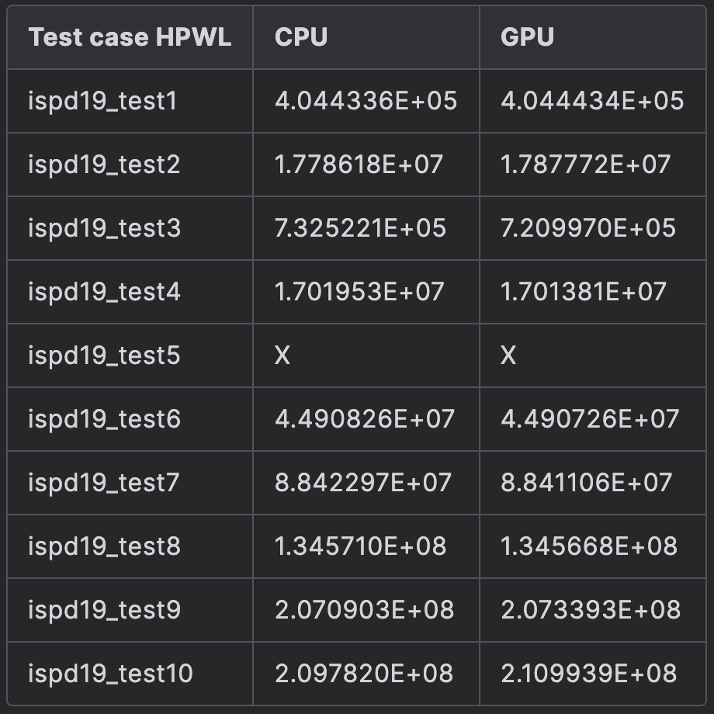
ISPD2019 Benchmarks
HPWL of each test case(CPU/GPU)

Slide 15
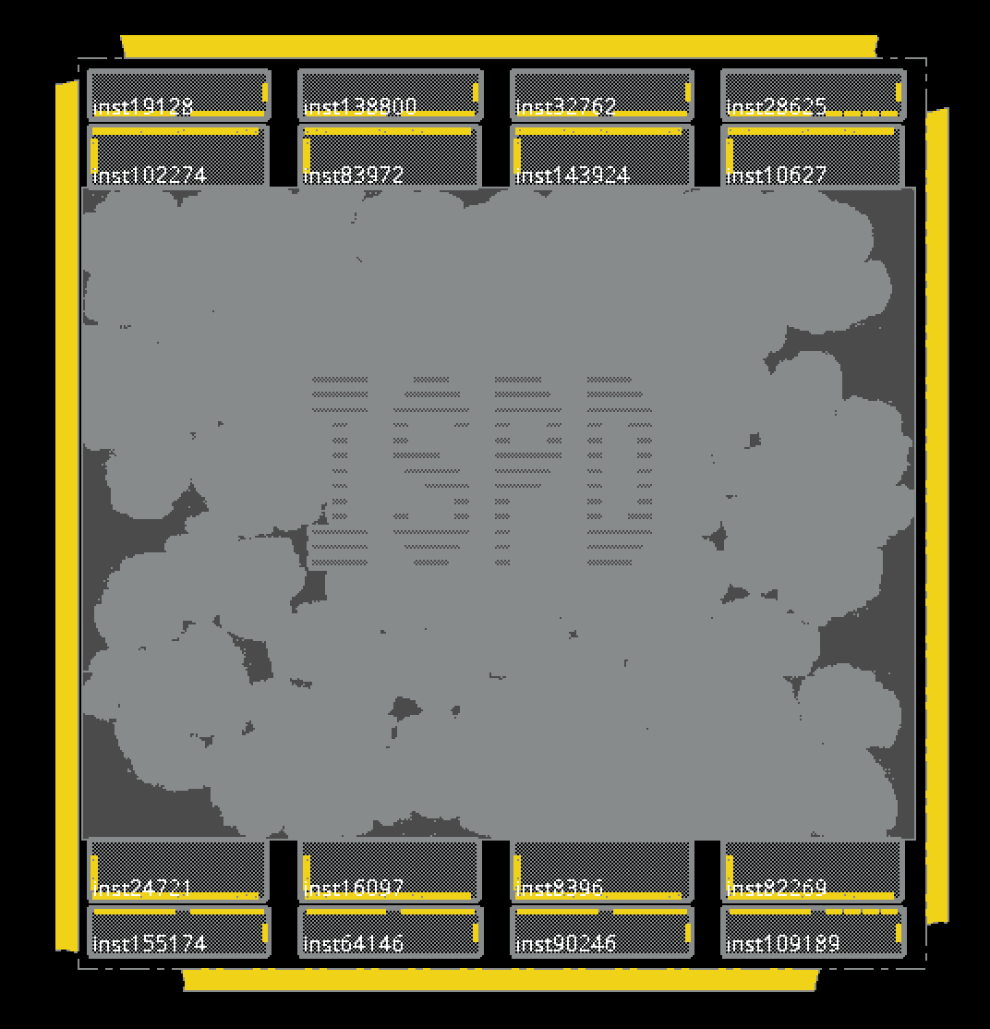

ISPD2019 Benchmarks
ispd_test10, 780 iterations

Slide 16
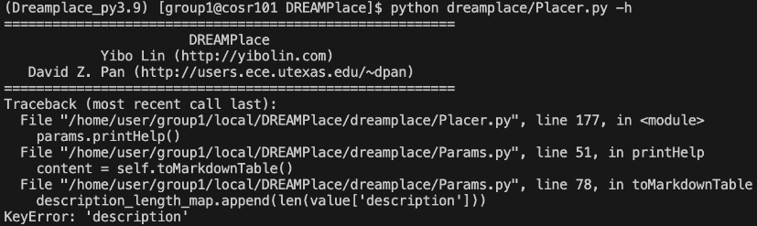
Issues
Install Dreaplce have some issue:
make -j $(nproc) can work
make -j$(nproc) cannot work
=> no space between -j and $(nproc)
cannot use -h to get the description of the json parameters
is a typo in /DREAMPlace/dreamplace/params.json
fixed by descripton => description

Slide 17
Issues
3. ERROR: Could not install packages due to an OSError: [Error 28] No space left on device
the reason : /tmp is full
solution :
mkdir -p $HOME/tmp
export TMPDIR=$HOME/tmp

Slide 18
Issues
4. ERROR : ispd_test5
Assertion `space >= node_size_x' failed: space 1, node_size_x[181] 2, original space (236, 237.995), site_width 1

Slide 19
DEMO TIME

